Slide 1
Longest Path Problem
Megan Hinkel and Jordan Martin

Slide 2
Longest Path Problem
Optimization Problem
Decision Problem
In a given graph, find the longest simple path possible.
A path is simple if it does not have any repeated vertices.
The length of a path can either be determined by the number of edges or the sum of the edges’ weights.
This problem is NP-Hard.
In a given graph, does a path of at least some given length exist?
This problem is NP-Complete.
It cannot be solved in polynomial time for arbitrary graphs.
However, it has a linear time solution for directed acyclic graphs (DAGs).

Slide 3
Example Inputs and Outputs
7 7
a b 10
a c 5
b d 10
c d 20
d e 10
a f 25
f g 25
Input:
The input is a directed, weighted graph, specified by a line containing the number of vertices n and the number of edges m followed by m lines containing the edges given in u v w format. This represents a an edge between u and v of weight w
50
a f g
5 5
a b 5
b c 5
c d 5
a e 10
e b 10
30
a e b c d
3 3
a b 3
b c 4
a c 5
7
a b c
Output:
The output consists of two lines containing the length of the path on one line (as an integer) followed by a list of vertices in the path on the second line.

Slide 4
Why Bellman-Ford Does Not Work
A longest path in a weighted graph G is the same as a shortest path in a graph −G, which is derived from G by changing every weight to its negation.
However, taking the negative weights on all the edges in a graph and using the Bellman-Ford algorithm does not work because it will not return the correct value!
This transformation is not useful because it creates cycles of negative length in −G.
If we continue to go around the negative cycle an infinite number of times, then the cost of the path will continually decrease (even though the length of the path is increasing).

Slide 5

Importance
The longest path problem has a wide range of relevant applications. Here are some examples:
Project management: The longest path in a project network represents the critical path, which is the sequence of tasks that will take longest to complete. Once this path is identified, those tasks can be prioritized and project delays can be minimized.
Circuit Design: The longest path problem can be used to optimize the timing of an electronic circuit. It ensures that signals can traverse through the circuit within any specified time constraints.

Slide 6

Importance
Software Development: Software components, such as modules or libraries, often have dependencies on each other. A graph would model the nodes as software components and edges as those dependencies. Identifying the longest path would reveal the most efficient way to download the software components and ensure that all dependencies are considered.
Computer Network Routing: Finding the longest path in computer networking systems can help optimize routing algorithms. It can be useful to identify the most efficient route between nodes.

Slide 7
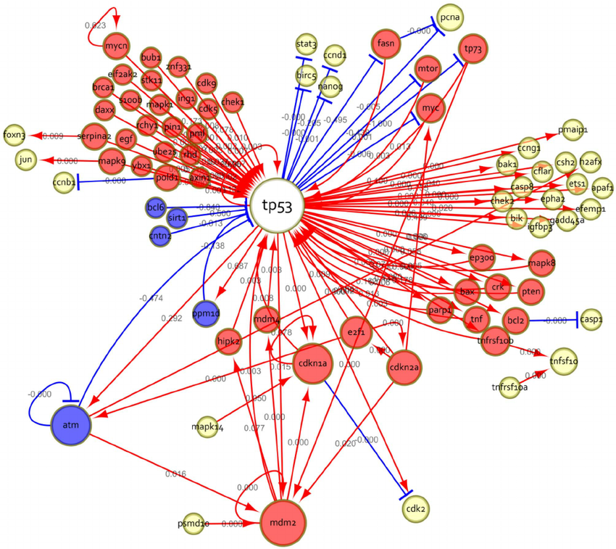
Importance
Biology: Gene regulatory networks can be represented as directed acyclic graphs, where nodes represent genes and edges represent regulatory relationships.
Finding the longest path in these networks has several uses, such as helping researchers understand the flow of information and hierarchy of gene regulation.
This information can be used to identify potential drug development targets and also to better understand how diseases develop.
Gene regulatory network for the p53 pathway

Slide 8
NP-Hard Reduction and Certifier Process
The Hamiltonian path problem can be reduced to the longest path problem to show that it is NP Hard.
A Hamiltonian path is a path that visits each vertex of the graph exactly once.
Given an instance G of Hamiltonian path, an instance (G’, K) of longest path is created as follows:
-Take G’ = G and set K = |V| - 1 (V = number of vertices in graph)
A simple path of length K in G’ exists if and only if G contains a Hamiltonian path.
Hamiltonian path is polynomial time reducible to longest path.

Slide 9
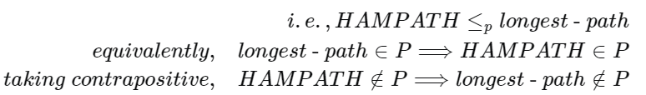
NP-Hard Reduction and Certifier Process
Since the Hamiltonian path problem is NP-complete, this reduction shows that the decision version of the longest path problem is also NP-complete:
-The input is a graph G and a number k; the desired output is yes if G contains a path of k or more edges, and no otherwise
If the longest path problem could be solved in polynomial time, it could be used to solve this decision problem by finding a longest path and then comparing its length to the number k.
Therefore, the longest path problem is NP-hard.

Slide 10
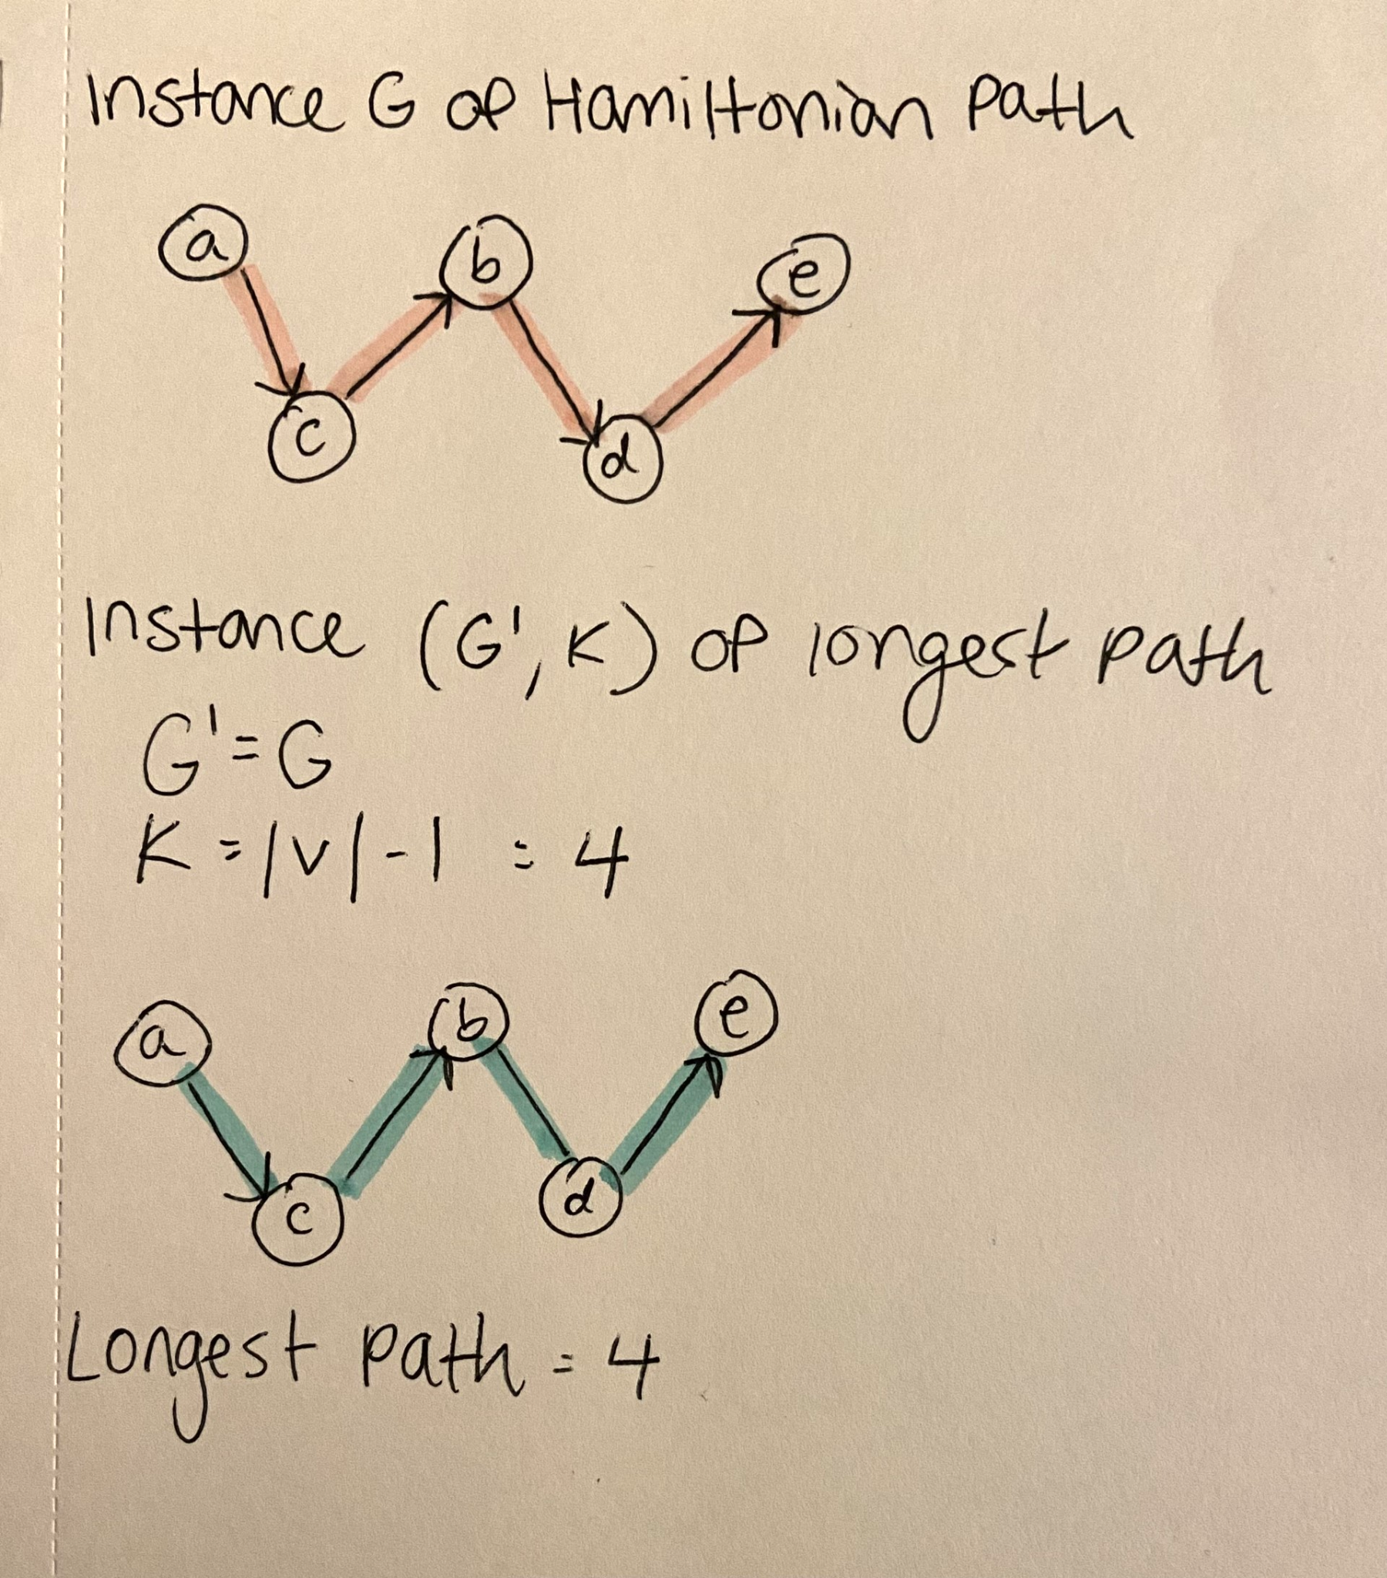
Example of a Reduction
A simple path of length 4 in G’ exists if and only if G contains a Hamiltonian path.

Slide 11
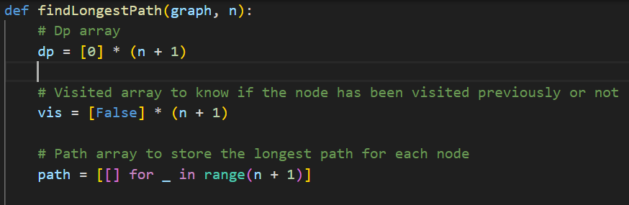
Explanation of Code
Our approach to the exact solution was to use a combination of Dynamic Programming and DFS.
The dynamic array holds the length of the longest path starting from the node at that index.
There is also a visited array to keep track of all the visited nodes during DFS and a path array to keep track of the vertices in the longest path for each node.

Slide 12
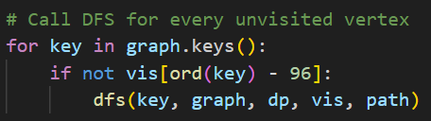
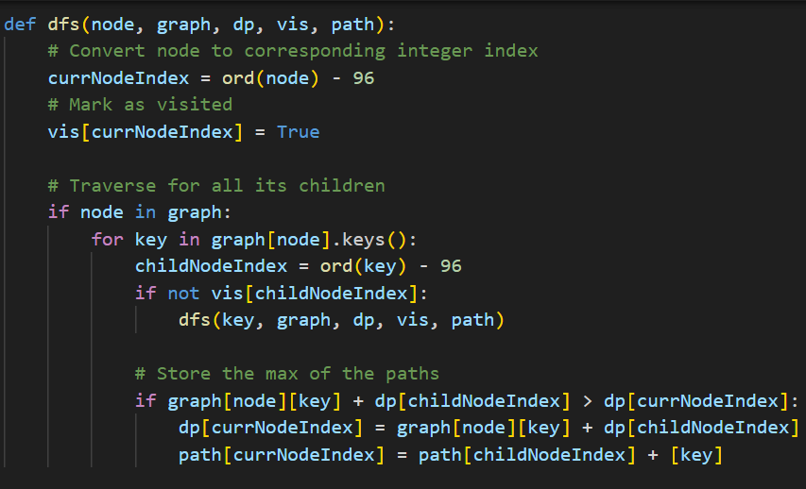
Explanation of Code
Then DFS is called on every node and all its children are traversed.
Below is the DFS algorithm we implemented.
Nodes are converted to their corresponding integer values (since they are given as characters)
The max value of the paths are stored in the dynamic array. The corresponding node is stored in the path array.
In this problem instance the longest path is is determined by the maximum weight of the edges in the path.

Slide 13
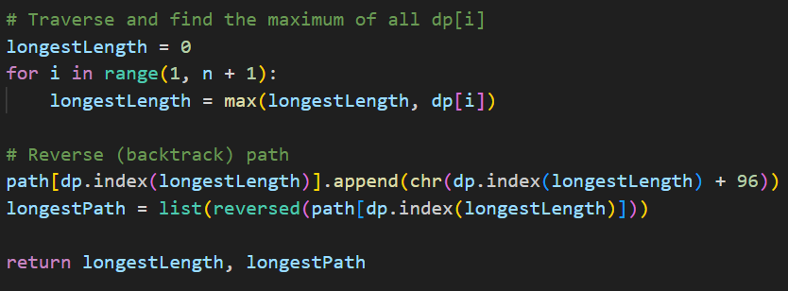
Explanation of Code
At the end, the dynamic array is checked for its max value, which is the longest path in the graph. To find the path that was taken, the list stored in the path array at the index of the longest path must be backtracked (because the nodes are added in reverse order).

Slide 14
Analytical Runtime Analysis
Time Complexity: O(V+E) where V = # of vertices and E = # of edges
Determined by DFS being run on every vertex in the graph and inside DFS the work is performed for every edge in the graph.

Slide 15
Analytical Runtime Analysis
Auxiliary Space: O(N)
There is some overhead for the data structures, whose length is determined by the number of vertices in the graph.

Slide 16
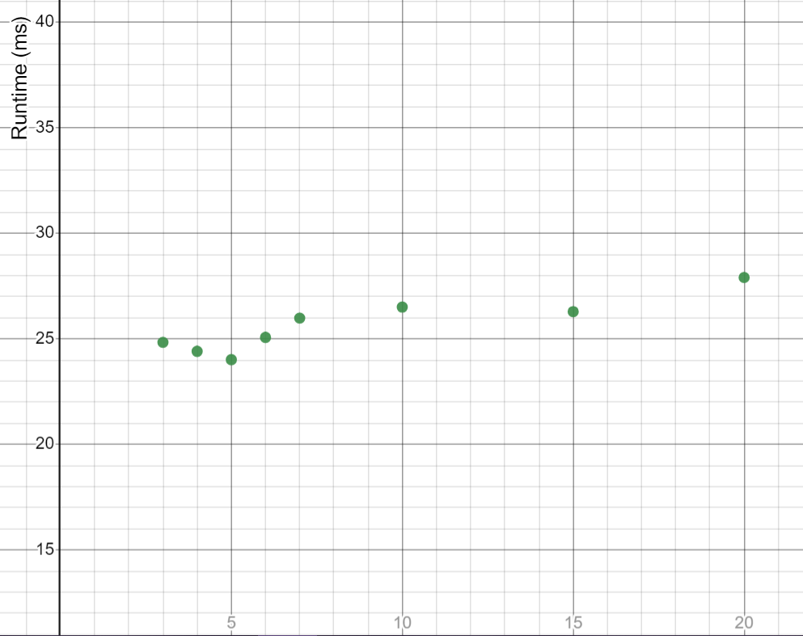
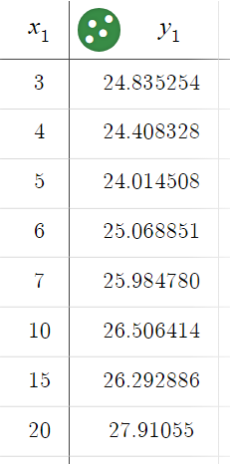
Empirical Runtime Analysis
To the right is the graph created based on the runtime of our test cases.
The X-axis represents the input size of the graph (Number of edges = number of vertices).
Input Size
The Y-axis represents the runtime of the test for that input size in milliseconds.
Overall, there is a slight linear increase, with the runtime increasing along with input size.

Slide 17
References
https://www.geeksforgeeks.org/longest-path-in-a-directed-acyclic-graph-dynamic-programming/
https://www.altcademy.com/blog/discover-the-longest-path-in-a-directed-acyclic-graph-solved/
https://www.csie.ntu.edu.tw/~lyuu/complexity/2016/20161129s.pdf
https://www.researchgate.net/figure/The-resulting-gene-regulatory-network-for-the-p53-pathway-Interactions-are-defined-by_fig7_263053629
https://ocw.mit.edu/courses/6-006-introduction-to-algorithms-fall-2011/5edb13fb34cbe7f4cdccc13d131772e7_MIT6_006F11_lec17.pdf

